Slide 1
BATTLE OF NEIGHBORHOOD FINDING A BETTER PLACE IN SCARBOROUGH, TORONTO
-Made by Abhinav

Slide 2
INTRODUCTION
Purpose of this Project is to help people in exploring better facilities around their neighborhood. It will help people making smart and efficient decision on selecting great neighborhood out of numbers of other neighborhoods in Scarborough, Toronto.
This project is for those people who are looking for better neighborhoods. For ease of accessing to Cafe, School, Super market, medical shops, grocery shops, mall, theatre, hospital, like minded people, etc.

Slide 3
ABOUT DATASET
Data is gathered from the following link:-
https://en.wikipedia.org/wiki/List_of_postal_codes_of_Canada:_M
Dataset consisting of latitude and longitude, zip codes.
Foursquare API to gather information about venues inside each and every neighborhood.
The data retrieved from Foursquare contained information of venues within a specified distance of the longitude and latitude of the postcodes.

Slide 4
ABOUT DATASET ( CONT’D)
The information obtained per venue as follows:
--Neighborhood
--Neighborhood Latitude
--Neighborhood Longitude
--Venue
--Name of the venue e.g. the name of a store or restaurant
--Venue Latitude
--Venue Longitude
--Venue Category

Slide 5
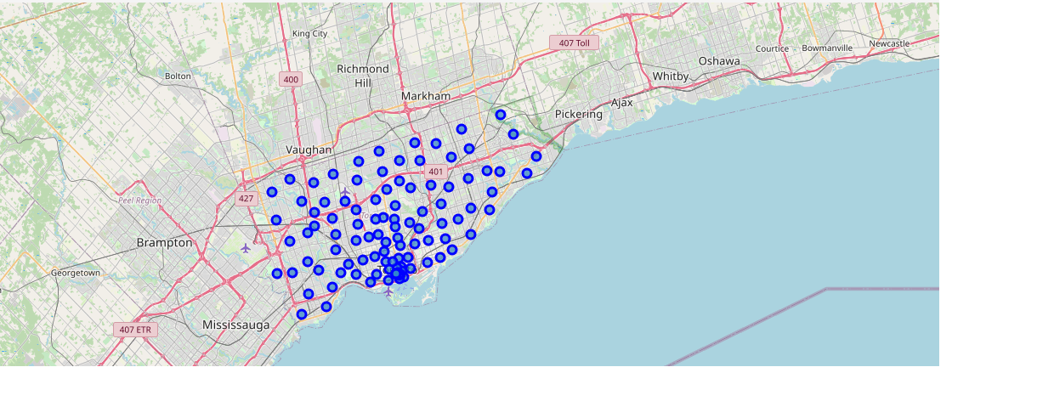
Map Of Scarborough

Slide 6
Methodology
Clustering Approach:
-- To compare the similarities of two cities, we decided to explore neighborhoods, segment them, and group them into clusters to find similar neighborhoods in a big city like New York and Toronto.
-- To be able to do that, we need to cluster data which is a form of unsupervised machine learning: k-means clustering algorithm.

Slide 7
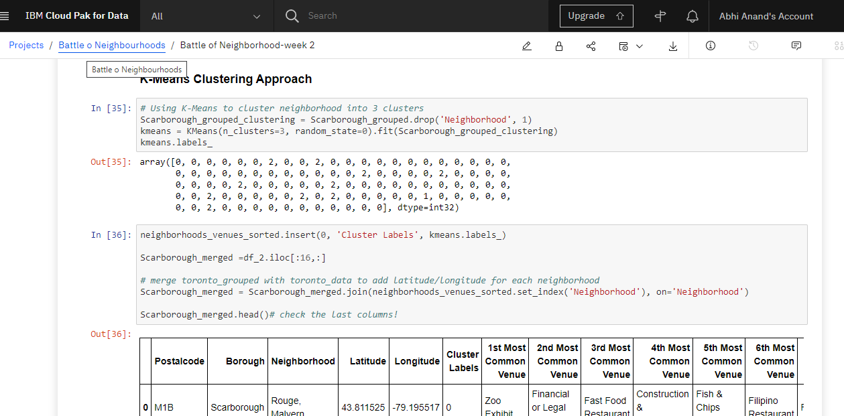

Slide 8
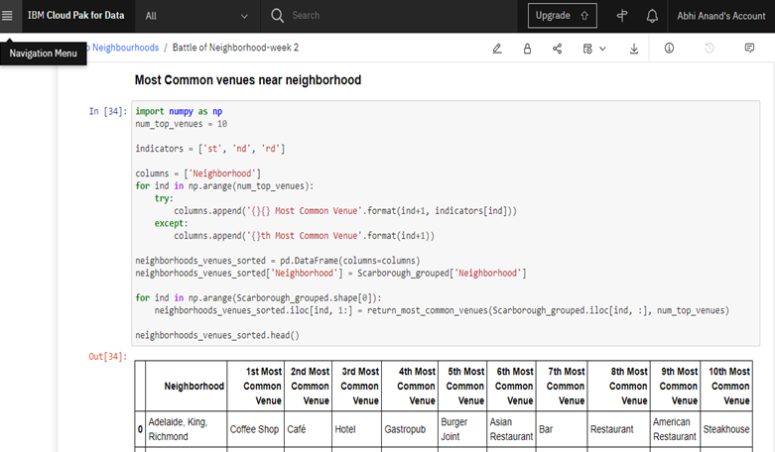

Slide 9
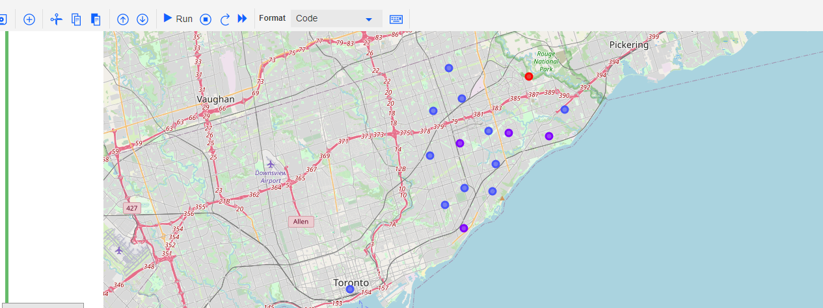
RESULTS
Map of Clusters in Scarborough

Slide 10
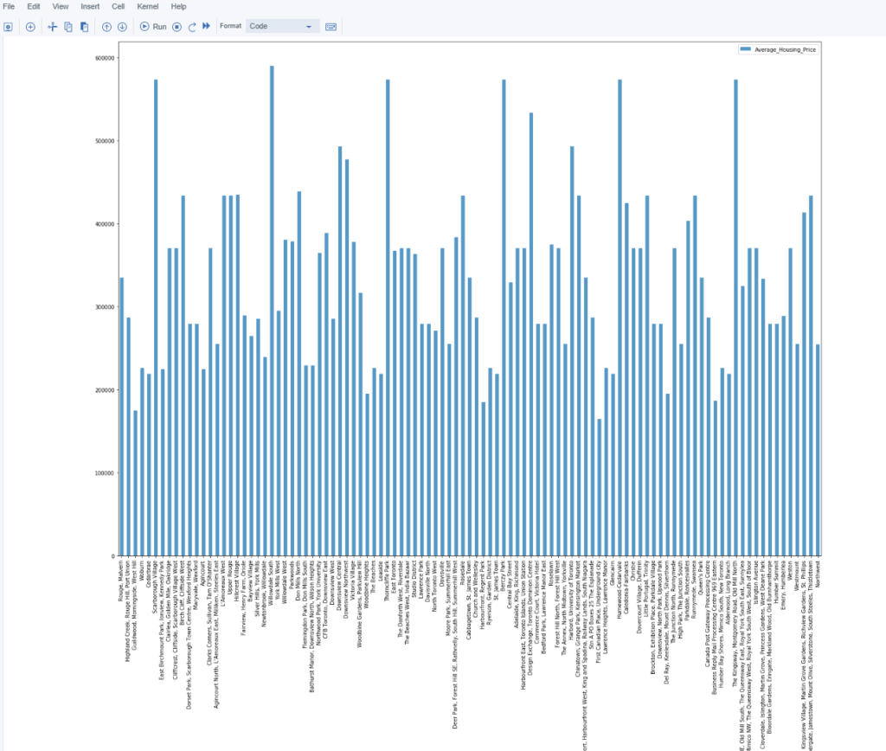
Average housing price by clusters in Scarborough

Slide 11
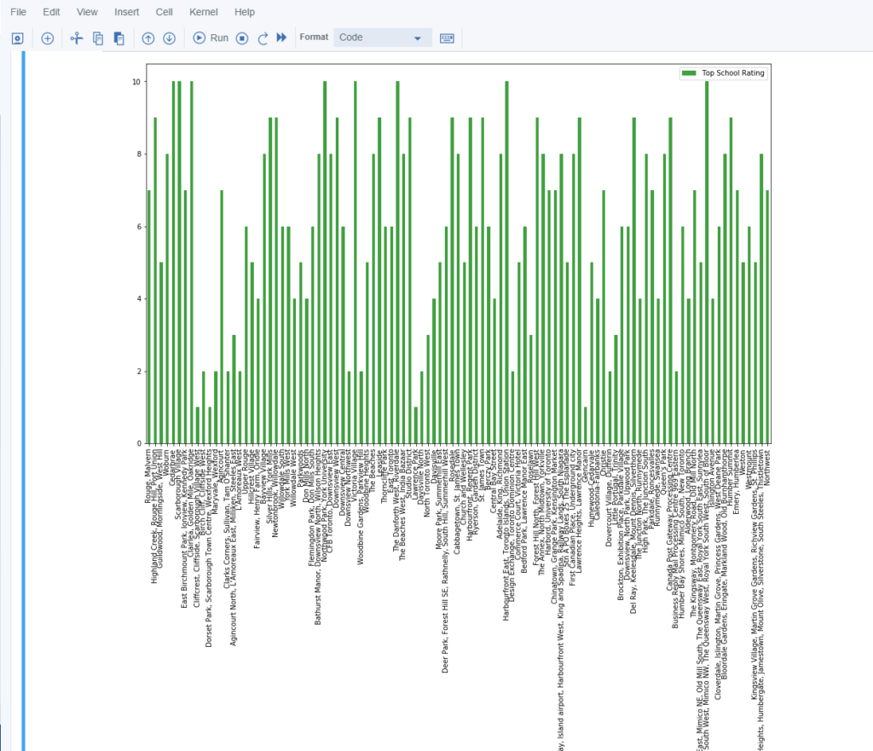
School Ratings by Clusters in Scarborough

Slide 12
Scarborough is a popular destination for new immigrants in Canada to reside.
As a result, it is one of the most diverse and multicultural areas in the Greater Toronto Area, being home to various religious groups and places of worship.
This project have used Four-square API as its prime data gathering source as it has a database of millions of places, especially their places API which provides the ability to perform location search, location sharing and details about a business.

Slide 13
CONCLUSIONS
In this project, using k-means cluster algorithm I separated the neighborhood into 10(Ten) different clusters and for 103 different lattitude and logitude from dataset, which have very-similar neighborhoods around them.
Using the charts above results presented to a particular neighborhood based on average house prices and school rating have been made.
The mapping with Folium is a very powerful technique to consolidate information and make the analysis and decision better with confidence.

Slide 14
FUTURE WORKS
This Capstone project can be continued for making it more precise in terms to find best house in Scarborough.
Best means on the basis of all required things(daily needs or things we need to live a better life) around and also in terms of cost effective.
It can also be used in the other places for finding the best suitable place for the business perspective as well as for the other purposes.

